Slide 1
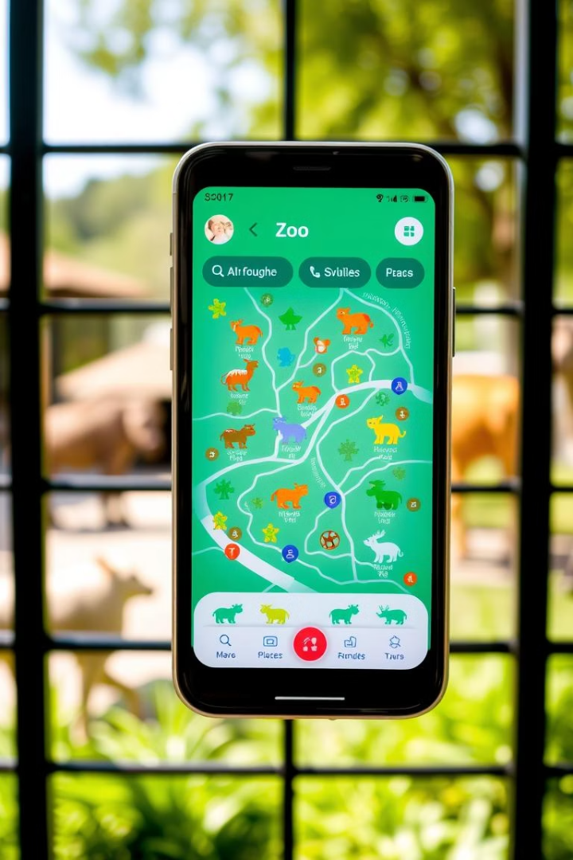

Zoo Explorer
Your Smart Guide to the Maryland Zoo
Android App Showcase
Welcome to the presentation of Zoo Explorer, an innovative Android app created as a college project. Designed to enhance visitor experience at the Maryland Zoo, it serves as a digital companion to guide guests seamlessly through exhibits and events. Join us as we explore its features, technology, and design highlights.

Slide 2


Introduction to Zoo Explorer
Visitor Engagement
Ease of Navigation
Boosts interest by providing detailed animal information, event updates, and interactive elements.
Offers an intuitive zoo map with clickable markers to simplify wayfinding across the park.
Real-Time Information
Delivers up-to-date event schedules and recommendations tailored to user preferences.

Slide 3

Key Features of Zoo Explorer
Explore Map
Animal Info with Detail Dialog
Event Schedule with Filters
Interactive, zoomable map with markers for all zoo exhibits and facilities.
Detailed species data including pictures, fun facts, and habitat info in pop-up dialogs.
Dynamic event lists with filtering by type, time, and location for personalized planning.
Personalized Recommendations
Clean and Accessible UI
Real-time suggestions based on user activity, weather, and favorite animals.
Designed with Material guidelines for ease of use across all visitor demographics.

Slide 4

Technical Stack Behind Zoo Explorer
Core Technologies
Support Tools & Libraries
Kotlin programming language for robust Android development
GitHub for version control and collaboration
Glide library for efficient image loading
Android Studio IDE with XML layouts for UI construction
RecyclerView for dynamic lists and efficient scrolling
ConstraintLayout for flexible and adaptive layouts
Material Components for modern, responsive UI

Slide 5


Home Screen User Interface
Cards for Tips
Navigation Buttons
Clean Layout
Visually distinct cards highlight visitor tips, daily highlights, and current events.
Easy-to-access buttons guide users to maps, animal info, and event screens seamlessly.
Designed for clarity and quick access to core app functions with minimal distraction.

Slide 6
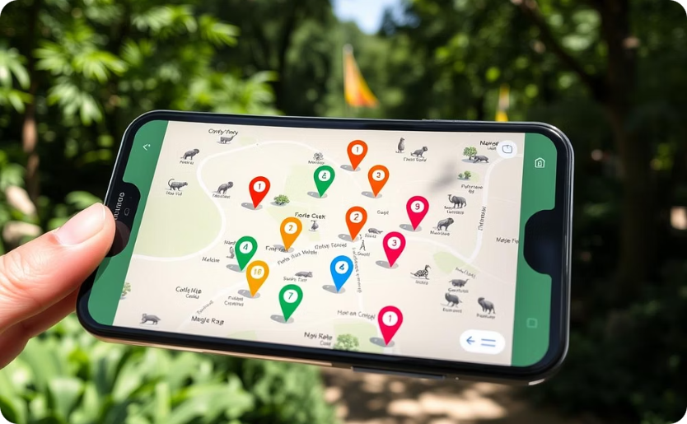
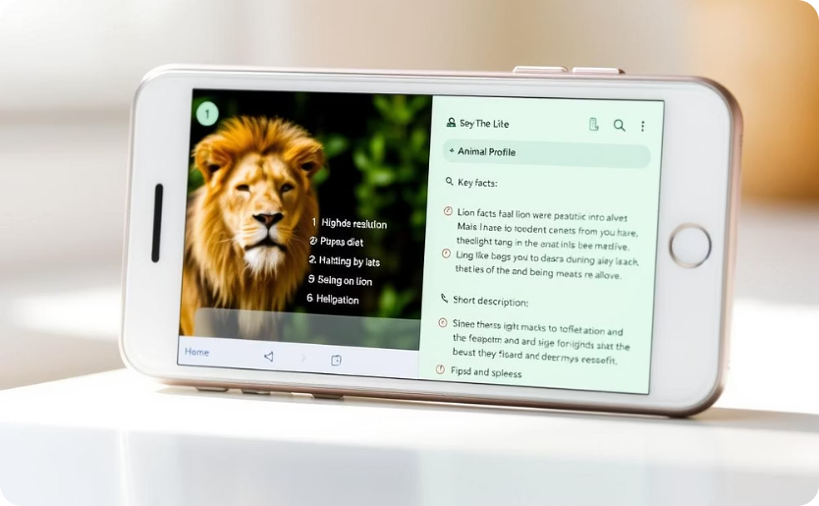

Interactive Map & Animal Cards
Clickable markers allow users to tap on locations for quick access to animal cards with photos and details.
Animal cards display in pop-up dialogs featuring images, facts, and audio, enriching user engagement.

Slide 7
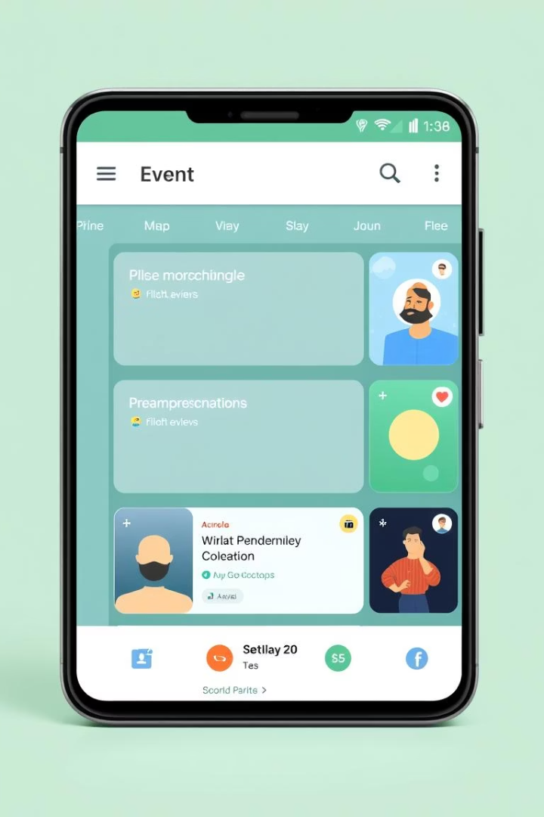




Event Screen with Filters
Filter Chips
Users can select chips to filter events by type, time slots, or locations effortlessly.
Event Cards
Cards display event details including time, description, and location in a scrollable format.
User Flow
Simple navigation with clear options helps visitors plan their zoo experience efficiently.

Slide 8

Challenges & Learnings
UI Polish
Balancing performance with responsiveness to create a smooth user experience.
DialogFragment Lifecycle
Managing fragment states to avoid crashes and data loss during navigation and screen orientation.
State Management & Interaction
Ensuring seamless user interactions with real-time event updates and map navigation.
User Experience
Prioritizing intuitive design to accommodate diverse visitor needs and tech familiarity.

Slide 9
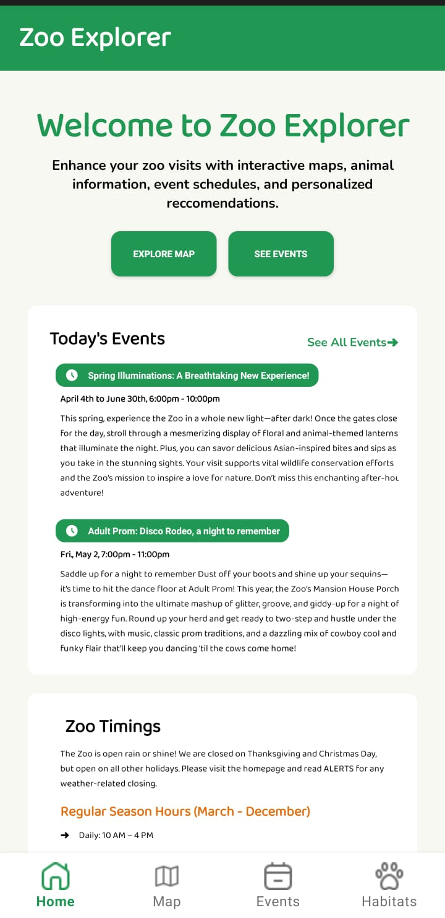

Screenshots:
Home:

Slide 10
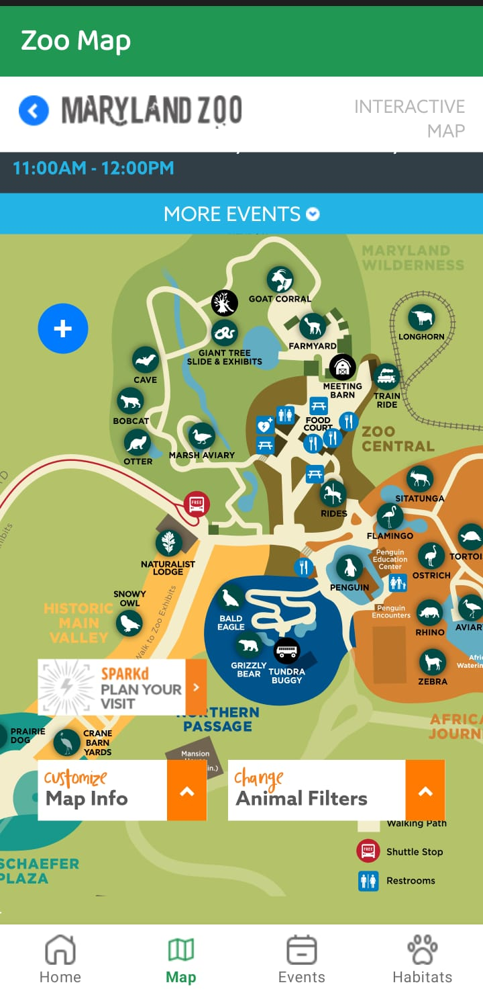


Map:

Slide 11
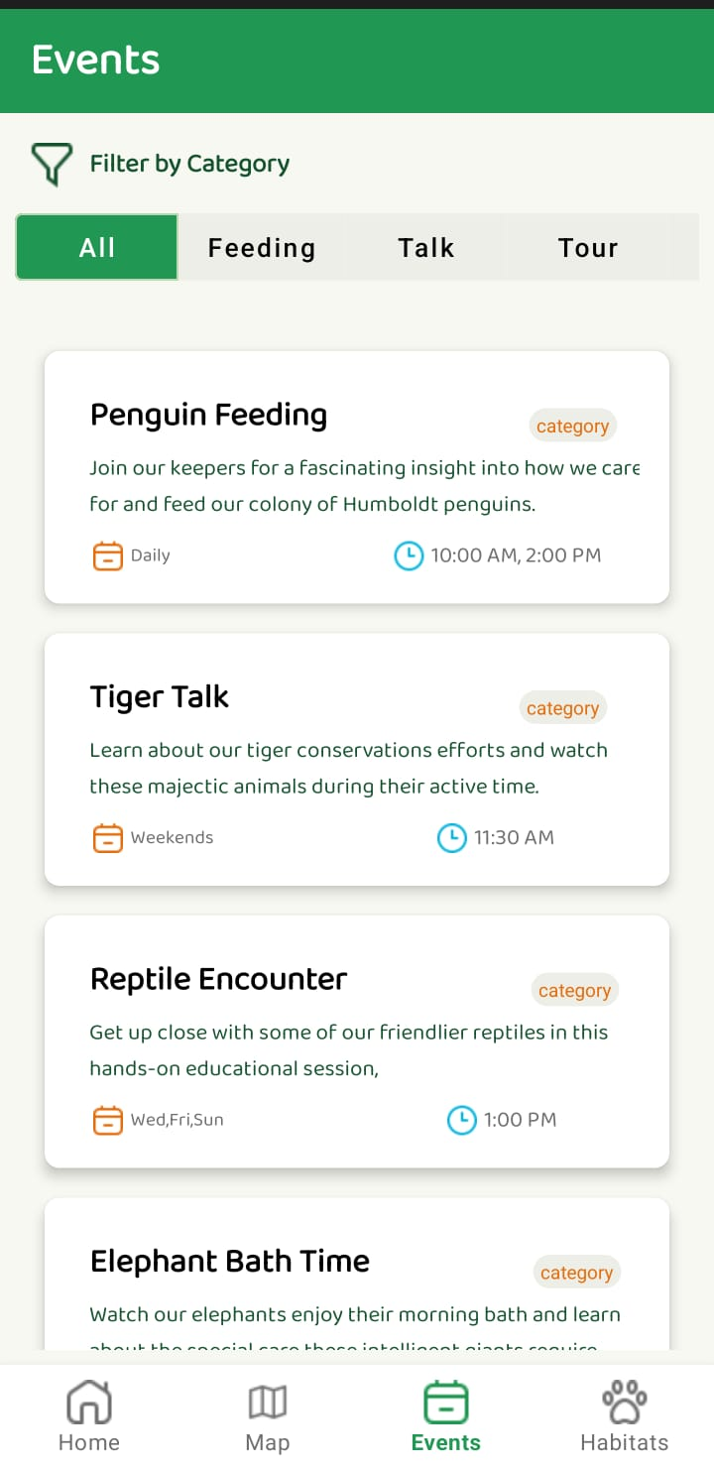


Events:

Slide 12
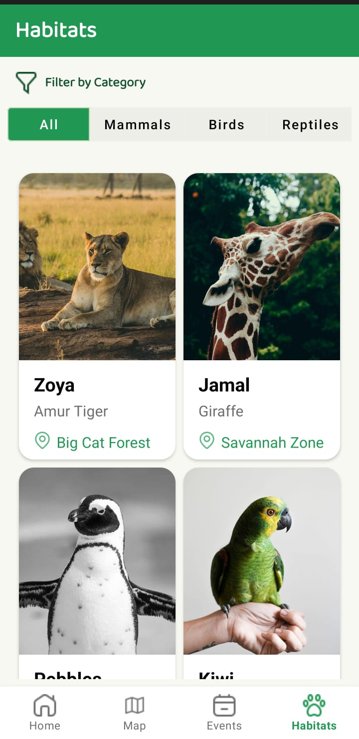
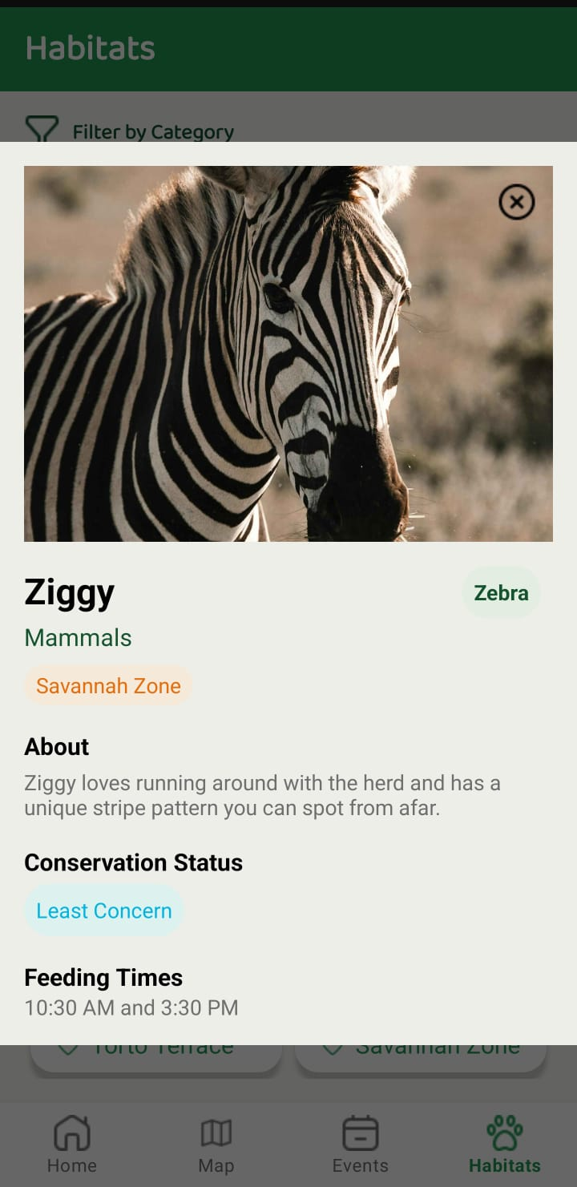

Habitats:

